Slide 1
Revitalizing Telangana Tourism
Key Insights and Recommendations

Slide 2
Table of Contents
Project Description
Introduction
About the Data
Data Insights & Visualization
Conclusion

Slide 3
Project Description
Problem Statement:
Telangana, which is one of the leading states in India, shares information about its tourism through an open data policy. However, the state has been experiencing a decrease in revenue. To address this issue, data analysts were given the responsibility of examining the available data, studying trends, and offering suggestions based on the findings. Their aim was to enhance administrative operations and find ways to increase revenue using data-driven insights.
Objective:
Provide Insights to Telangana Government Tourism Department

Slide 4
Introduction
Formed as the 29th State of India, Telangana came into being on the 2nd of June, 2014. The State has an area of 1,12,077 sq. Km. and has a population of 3,50,03,674 (2011 Census). The Telangana region was part of the Hyderabad state from 17th September 1948 to 1st November 1956, until it was merged with Andhra State to form Andhra Pradesh.
After decades of movement for a separate State, Telangana was created by passing the AP State Reorganization Bill in both houses of Parliament. Telangana is surrounded by Maharashtra and Chhattisgarh in the North, Karnataka in the West and Andhra Pradesh in the South and East directions. Major cities of the State include Hyderabad, Warangal, Nizamabad, Nalgonda, Khammam and Karimnagar.

Slide 5
About the Data
This is the data for Telangana government Tourism Department and this data set have incoming domestic and foreign visitors count for the period of 2016– 2019. These details have been stored in year wise excel sheets.
We have two folders --
1. Domestic Visitors
2. Foreign Visitors
- Each folder contains the data of visitors from years 2016 to 2019 with separate files.

Slide 6
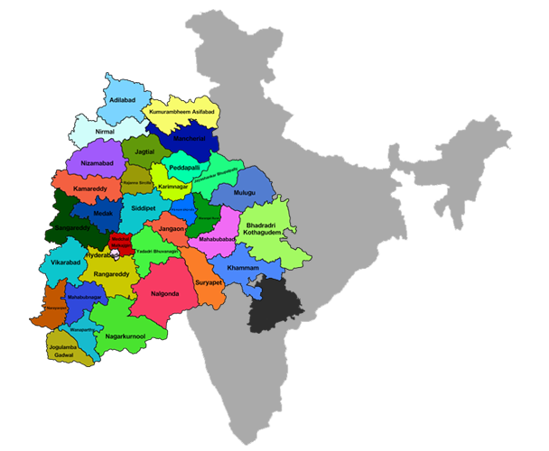
Data Insights and Visualizations →

Slide 7
Query 1:-
List down the top 10 districts that have the highest number of domestic visitors overall (2016 - 2019)?
district | visitors
Hyderabad | 83900960
Rajanna Sircilla | 41763276
Warangal (Urban) | 30726603
Yadadri Bhongir | 26893080
Bhadradri Kothagudem | 21600962
Medak | 20542639
Jayashankar Bhoopalpally | 19632865
Mahbubnagar | 17180118
Nirmal | 13315796
Jagtial | 11303514
Key Insights:-
- The top 3 visited Districts are Hyderabad (23.55%) , Rajanna Sircilla(11.72%) and Warangal (urban) (8.62 %).

Slide 8
Query 2:--- List down the top 3 districts based on Compounded annual growth rate (CAGR) of visitors between (2016 - 2019)?
Top 3 Districts of Domestic and Foreign Visitors
Key Insights:
To see that Mancherial, Warangal and Bhadradri Kothagudem has highest CAGR.
While Nagarkurnool, Jogulamba and Hyderabad has lowest CAGR.

Slide 9
Query 3:---- List down the bottom 3 districts based on Compounded annual growth rate (CAGR) of visitors between (2016 - 2019)?
Key Insights:
- Karimnagar and Jangaon are the least districts based on CAGR.

Slide 10
Query 4:--- What are the peak and low season months for Hyderabad based on the data from 2016 to 2019 for Hyderabad district?
Peak Seasons of Hyderabad
Key Insights:
Foreign Countries visits Hyderabad mostly in December, January and February months.
While Domestic visitors visits mostly in June, December, October.

Slide 11
Low Seasons with Domestic and Foreign Visitors:
Key Insights:
To see in the table lowest month is February with Domestic visitors.
While for the foreign visitors May was the lowest season.

Slide 12
Query 5: --- Show the top and bottom 3 districts with high domestic to foreign tourist ratio?
Key Insights:
Hyderabab, Warangal and Mulugu are the top districts having high domestic to foreign tourist ratio.
While at the bottom Nirmal, Jangaon and Adilabad are least domestic to foreign tourist ratio.

Slide 13
Query 6:--- list the top and bottom 5 districts based on 'population to tourist footfall ratio*' ratio in 2019?
Key Insights:
- Mulugu has the highest footfall ratio and Peddapalli has the lowest footfall ratio with domestic visitors.

Slide 14
Footfall ratio of Foreign visitors:
Key Insights:
Here only Hyderabab and Mulugu districts have good footfall ratio with Foreign Visitors.
May it’s because of Hyderabad has many places to visit compared to other districts.

Slide 15
THANK YOU

